Slide 1
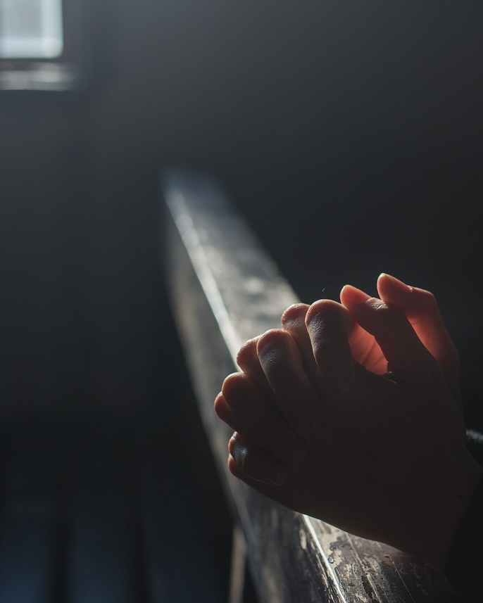
Great Faith
Matthew 8:5-13
Matthew 15:21-28

Slide 2
The Centurion
“And when Jesus entered Capernaum, a centurion came to Him, imploring Him, and saying, "Lord, my servant is lying paralyzed at home, fearfully tormented." Jesus *said to him, "I will come and heal him." But the centurion said, "Lord, I am not worthy for You to come under my roof, but just say the word, and my servant will be healed. "For I also am a man under authority, with soldiers under me; and I say to this one, 'Go!' and he goes, and to another, 'Come!' and he comes, and to my slave, 'Do this!' and he does it." Now when Jesus heard this, He marveled and said to those who were following, "Truly I say to you, I have not found such great faith with anyone in Israel. "I say to you that many will come from east and west, and recline at the table with Abraham, Isaac and Jacob in the kingdom of heaven; but the sons of the kingdom will be cast out into the outer darkness; in that place there will be weeping and gnashing of teeth." And Jesus said to the centurion, "Go; it shall be done for you as you have believed." And the servant was healed that very moment.” (Matthew 8:5-13)

Slide 3
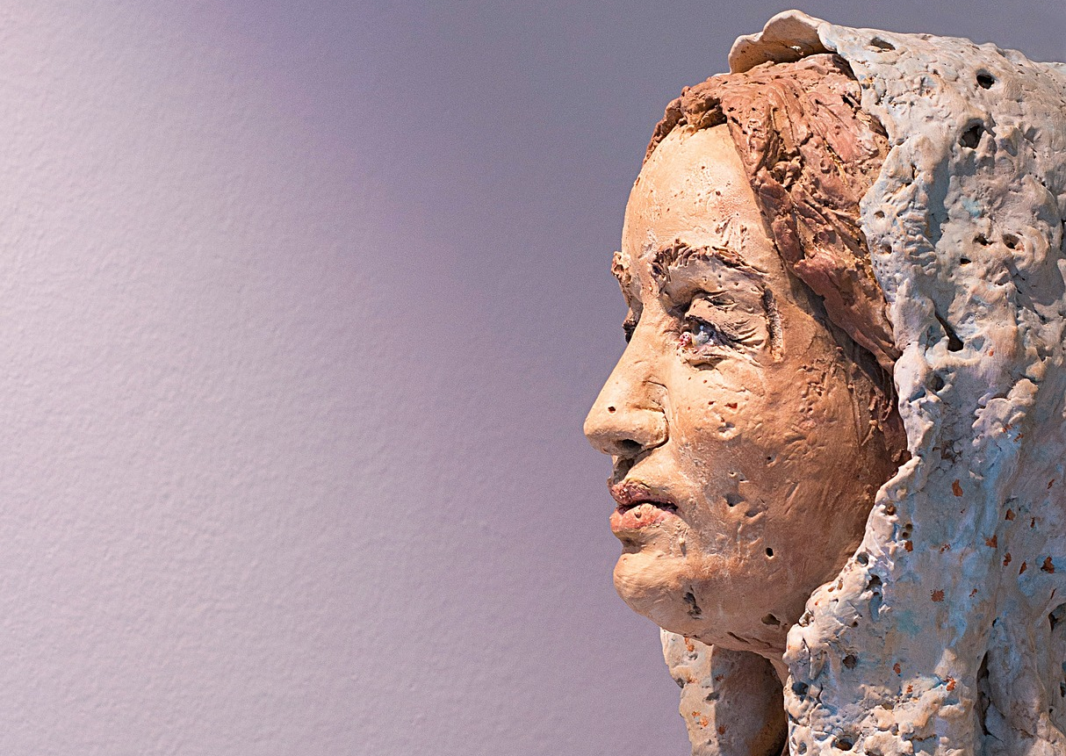
The Canaanite Woman
“Jesus went away from there, and withdrew into the district of Tyre and Sidon. And a Canaanite woman from that region came out and began to cry out, saying, "Have mercy on me, Lord, Son of David; my daughter is cruelly demon-possessed." But He did not answer her a word. And His disciples came and implored Him, saying, "Send her away, because she keeps shouting at us." But He answered and said, "I was sent only to the lost sheep of the house of Israel." But she came and began to bow down before Him, saying, "Lord, help me!" And He answered and said, "It is not good to take the children's bread and throw it to the dogs." But she said, "Yes, Lord; but even the dogs feed on the crumbs which fall from their masters' table." Then Jesus said to her, "O woman, your faith is great; it shall be done for you as you wish." And her daughter was healed at once.” (Matthew 15:21-28)

Slide 4
Great Faith...
Both asked for what they did not deserve.
Both asked on behalf of someone else.
Both had recognized Jesus’ power and compassion.

Slide 5
Great Faith Is Persistent Faith!
Keep asking when God is silent.
Jesus did not initially respond. (Matthew 15:22-23)
It was her persistence that led to a response. (cf. Luke 11:5-10)
God may have reasons for not responding.
“Prayer works best when it is our only plan.” – Paul Earnhart

Slide 6
Great Faith Is Persistent Faith!
Keep asking when God is silent.
Keep asking when others try to discourage you.
The disciples saw her as a nuisance. (Matthew 15:23)
Her response was to “bow down.” (Matthew 15:25)
She was bold but reverent.
She remained focused on Jesus.

Slide 7
Great Faith Is Persistent Faith!
Keep asking when God is silent.
Keep asking when others try to discourage you.
Keep asking even though you are unworthy.
Jesus: “I was sent only to the lost sheep of Israel...” and “It is not good to take the children’s bread and throw it to the dogs. “ (Matthew 15:24, 26)
Her response: “...Lord help me.” and “Yes Lord; but even the dogs feed on the crumbs...” (Matthew 15:25, 27)

