Slide 1
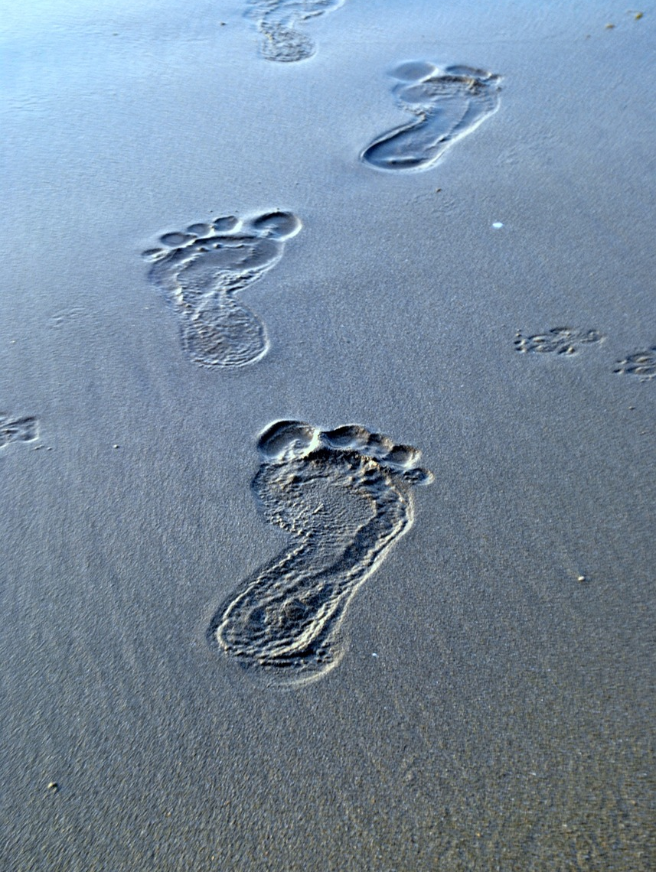
Authentic Discipleship
Learning to Follow
Jesus

Slide 2
Following Jesus
“Be imitators of me, just as I also am of Christ.” (1 Corinthians 11:1)
“You also became imitators of us and of the Lord, having received the word in much tribulation with the joy of the Holy Spirit,” (1 Thessalonians 1:6)
“The first account I composed, Theophilus, about all that Jesus began to do and teach, until the day when He was taken up to heaven...” (Acts 1:1-2)

Slide 3
Jesus & Stephen
Jesus
Jesus called men to repent in the Synagogue. (Luke 4:16-31)
Jesus prayed for His murderers. (Luke 23:34)
Jesus trusted God absolutely. (Luke 23:46)
Stephen
Stephen called men to repent in the Synagogue. (Acts 6:9; 7:51-53)
He trusted Jesus absolutely. (Acts 7:59)
He prayed for His murderers. (Acts 7:60)

Slide 4
Jesus & Paul
Jesus
It begins with a resolve to go to Jerusalem. (Luke 9:51)
There are then a series of Predictions. (Luke 13:33; 18:31-33)
Jesus is arrested by the Jews, handed over to the gentiles and crucified.
Paul
It begins with a resolve to go to Jerusalem. (Acts 19:21)
There are then a series of Predictions. (Acts 20:22-23; 21:4, 10-12)
Paul is arrested by the Jews and taken by the gentiles...

Slide 5
Jesus & Us
“And He was saying to them all, 'If anyone wishes to come after Me, he must deny himself, and take up his cross daily and follow Me. For whoever wishes to save his life will lose it, but whoever loses his life for My sake, he is the one who will save it. For what is a man profited if he gains the whole world, and loses or forfeits himself?” (Luke 9:23-25)

Slide 6
Authentic Discipleship
“Be imitators of me, just as I also am of Christ.”
(1 Corinthians 11:1)

